Slide 1
Web Development: Experiments (& a little bit about personal website)
Yi-Chia Chen, UCLA postdoc
https://ycc.vision/

Slide 2
Change Log
2021.12.14
Updated information
Add browser fingerprinting information
2023.06.28
Updated information
Add JS framework information
2023.06.29
Extend protocol introduction

Slide 3
Change Log
2020.10.06
Added resources
Network throttling for testing effects of slow internet speed on experiments
Crib sheet for converting Python to JavaScript
A website to detect and inform users to update browsers
paid service for browser compatibility tests
Updated information
A few typo corrections and formatting
A hosted example experiment

Slide 4
Change Log
2020.05.26:
Added resources
W3C Markup Validation Service: https://validator.w3.org/
CSS-Tricks: https://css-tricks.com/
CodePen: https://codepen.io/
Browsersync: https://www.browsersync.io/
Academicons: https://jpswalsh.github.io/academicons/
Updated information
Caveats on canplaythrough event: http://dinbror.dk/blog/how
Page visibility API is not perfect for tab switching detection, but is the best exists
SONA automatic credit granting can be done on customized websites too

Slide 5
Outline
How the modern internet works
How online experiment works
Basic concepts and structures of websites
HTML, CSS, JavaScript, JQuery, PHP, ……
Common problems and solutions
How to stay current?
Example code
Extra bit on personal website

Slide 6
A few thoughts……
Rethink your timeline and devote more time for programming
Converting code directly to online experiments
Learning JavaScript now is a must
Not dependent on any services (especially new ones)
Eternally useful for experiments & websites
Slower is faster

Slide 7
Code conversion (If you insist)
PsychoPy Builder to PsychoJS
https://www.psychopy.org/online/index.html
Crib sheet: https://docs.google.com/document/u/0/d/13jp0QAqQeFlYSjeZS0fDInvgaDzBXjGQNe4VNKbbNHQ/mobilebasic#heading=h.fbo8f8y1ynwk
PsychoPy to executables
https://www.psychopy.org/recipes/appFromScript.html
MATLAB base code to JavaScript
https://www.mathworks.com/matlabcentral/fileexchange/69973-generate-javascript-using-matlab-coder
NOT for Psychtoolbox
Psychtoolbox to executables (Maybe)
https://www.mathworks.com/products/matlab-coder.html
YouTube tutorial: https://www.youtube.com/watch?v=FZWwqFgzO9w

Slide 8
Easier builders
Qualtrics (account purchased by labs)
Gorilla: https://gorilla.sc/
p5.js: https://p5js.org/
Labvanced: https://www.labvanced.com/
jsPsych: https://www.jspsych.org/
lab.js: https://lab.js.org/
Testable: https://www.testable.org/
PsyToolkit: https://www.psytoolkit.org/

Slide 9
Easier builders
Qualtrics (account purchased by labs)
Gorilla: https://gorilla.sc/
p5.js: https://p5js.org/
Labvanced: https://www.labvanced.com/
jsPsych: https://www.jspsych.org/
lab.js: https://lab.js.org/
Testable: https://www.testable.org/
PsyToolkit: https://www.psytoolkit.org/
Anwyl-Irvine, A. L., Massonnié, J., Flitton, A., Kirkham, N., & Evershed, J. K. (2020). Gorilla in our midst: An online behavioral experiment builder. Behavior research methods, 52, 388-407.

Slide 10
Outline
How the modern internet works
How online experiment works
Basic concepts and structures of websites
HTML, CSS, JavaScript, JQuery, PHP, ……
Common problems and solutions
How to stay current?
Example code
Extra bit on personal website

Slide 11
Outline
How the modern internet works
How online experiment works
Basic concepts and structures of websites
HTML, CSS, JavaScript, JQuery, PHP, ……
Common problems and solutions
How to stay current?
Example code
Extra bit on personal website
Return to Outline link page

Slide 12






Modern Internet
Your
Devices
Your Router/
Modem
Internet Service Provider
Network Service Provider

Slide 13




Modern Internet
Your
Devices
Your Router/
Modem
Internet Service Provider
Network Service Provider

Slide 14
Modern Internet
Internet Service Provider
Network Service Provider
Internet Service Provider

Slide 15
Modern Internet

Slide 16
Modern internet
Internet Service Provider
Network Service Provider
Internet Service Provider

Slide 17
Modern Internet
Internet Backbone
Internet Service Provider
Network Service Provider
Internet Service Provider

Slide 18
Modern Internet
Internet Backbone
(More connected computers
across the world)
Internet Service Provider
Network Service Provider
Internet Service Provider

Slide 19
Modern Internet
Internet Backbone
(More connected computers
across the world)
Internet Service Provider
Network Service Provider
Internet Service Provider
NTT, AT&T, Verizon
Comcast/Xfinity

Slide 20
Modern Internet
Internet Backbone
(More connected computers
across the world)
Internet Service Provider
Network Service Provider
Internet Service Provider
NTT, AT&T, Verizon
Comcast/Xfinity

Slide 21
Modern Internet
Your
Devices
Your Router/
Modem
Internet Service Provider
Network Service Provider

Slide 22
Modern Internet
Your
Devices
Your Router/
Modem
Internet Service Provider
Network Service Provider
The dark web is different here!
(Note that deep web != dark web)

Slide 23

Modern Internet
Your
Devices
Your Router/
Modem
Internet Service Provider
Network Service Provider

Slide 24

Modern Internet
Your
Devices
Internet Service Provider
Router
Modem

Slide 25
Modern Internet
Electronic signals (Phone line
TV cable
Power line
Satellite)
Your
Devices
Internet Service Provider
Router
Modem

Slide 26
Modern Internet
Electronic signals (Phone line
TV cable
Power line
Satellite)
Your
Devices
Internet Service Provider
Router
Modem
Translation to digital signals
Public IP address

Slide 27
Modern Internet
Electronic signals (Phone line
TV cable
Power line
Satellite)
Actual cable at your house
Your
Devices
Internet Service Provider
Router
Modem
Translation to digital signals
Public IP address

Slide 28
Modern Internet
Electronic signals (Phone line
TV cable
Power line
Satellite)
Actual cable at your house
Your
Devices
Internet Service Provider
Router
Modem
Translation to digital signals
Public IP address
Connects to your devices
Local (Private) IP addresses

Slide 29
Modern Internet
Electronic signals (Phone line
TV cable
Power line
Satellite)
Actual cable at your house
Wi-Fi or cable
Your
Devices
Internet Service Provider
Router
Modem
Translation to digital signals
Public IP address
Connects to your devices
Local (Private) IP addresses

Slide 30
Modern Internet
Electronic signals (Phone line
TV cable
Power line
Satellite)
Actual cable at your house
Wi-Fi or cable
Your
Devices
Internet Service Provider
Router
Modem
I recommend ASUS
Hardware to software
Translation to digital signals
Public IP address
Connects to your devices
Local (Private) IP addresses

Slide 31
Modern Internet
Electronic signals (Phone line
TV cable
Power line
Satellite)
Actual cable at your house
Wi-Fi or cable
Your
Devices
Internet Service Provider
Router
Modem
I recommend ASUS
Hardware to software
Translation to digital signals
Public IP address
Connects to your devices
Local (Private) IP addresses

Slide 32
Modern Internet
IP addresses?
Protocols?
Websites?
Signals?
Hardware to software magic?
WWW?
Email?

Slide 33
Modern Internet
IP addresses?
Protocols?
Websites?
Signals?
Hardware to software magic?
WWW?
Email?

Slide 34
Public IP Addresses
156.33.241.5 (US Senate)
Google my IP or access your router’s page
Your address in the internet world
One public IP per local network
Publicly accessible
It is NOT fixed for most people: Tracking individual with IP is not very useful
NOT the main way you are identified online (e.g., FB, Amazon, Google)
Cookies
Devices
Browser fingerprinting

Slide 35
Public IP Addresses
156.33.241.5 (US Senate)
Google my IP or access your router’s page
Your address in the internet world
One public IP per local network
Publicly accessible
It is NOT fixed for most people: Tracking individual with IP is not very useful
NOT the main way you are identified online (e.g., FB, Amazon, Google)
Cookies
Devices
Browser fingerprinting

Slide 36
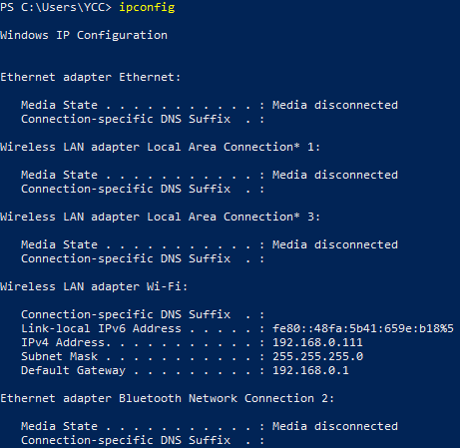
Local IP Addresses
Each device has one
They are managed by your router
They can be the same in in different local networks

Slide 37
Local IP Addresses
Each device has one
They are managed by your router
They can be the same in in different local networks

Slide 38
IPv4 & IPv6
Internet protocol version 4 address
Internet protocol version 6 address

Slide 39
Modern Internet

Slide 40
IPv4 & IPv6
Internet is growing too big and needs more addresses than 4 set of numbers
Now IPv4 and IPv6 coexist
Gradually shifting to IPv6
IPv6 occupy 39–43% of global traffic (as of March 2023 estimated by Google)

Slide 41
Protocol Stack
The standard of how to write a letter
E.g., Envelops, names, addresses, stamps, etc.
With additional information for the translators on the way

Slide 42





Protocol Stack
In what format?
Which app to talk to?
Which device to talk to?
Electrical Signals to Digital Signals

Slide 43
Protocol Stack
In what format?
Which app to talk to?
Which device to talk to?
Electrical Signals to Digital Signals

Slide 44
Protocol Wars
TCP/IP Model
Transmission Control Protocol /Internet Protocol
Internet protocol suite
Older
OSI Model
Open Systems Interconnection
Newer

Slide 45
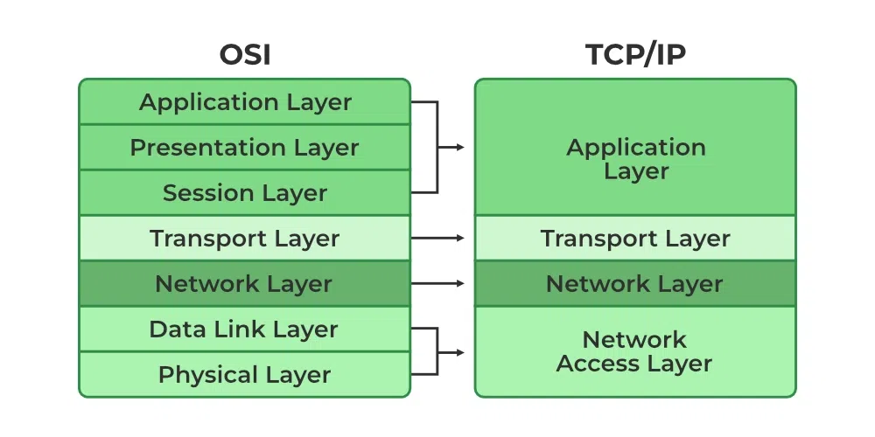

Slide 46
TCP/IP Model
Application
Protocols specific to applications
Transport
Directs data to an application
through a computer port
Network
Directs data to a computer
using an address
Network Access
Translates between binary data
and network signals

Slide 47
TCP/IP Model
Application
HTTP, SMTP, Telnet, FTP…
Transport
TCP, UDP…
Network
IPv4, IPv6…
Network Access
I don’t know much here

Slide 48
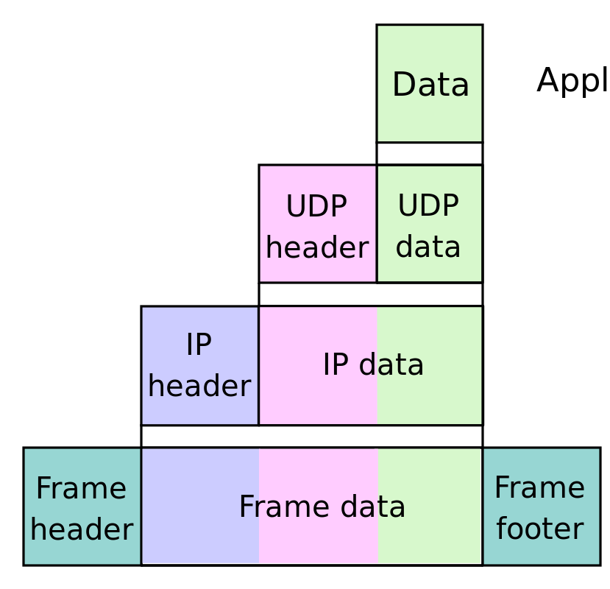
Encapsulation (Sender)
Application
Transport
Network
Network Access

Slide 49
Encapsulation (Sender)
Application
Transport
Network
Network Access

Slide 50
Encapsulation (Sender)
Application
Transport
Network
Network Access

Slide 51
Encapsulation (Sender)
Application
Transport
Network
Network Access

Slide 52
Deencapsulation (Receiver)
Application
Transport
Network
Network Access

Slide 53
Deencapsulation (Receiver)
Application
Transport
Network
Network Access

Slide 54
Deencapsulation (Receiver)
Application
Transport
Network
Network Access

Slide 55
Deencapsulation (Receiver)
Application
Transport
Network
Network Access

Slide 56
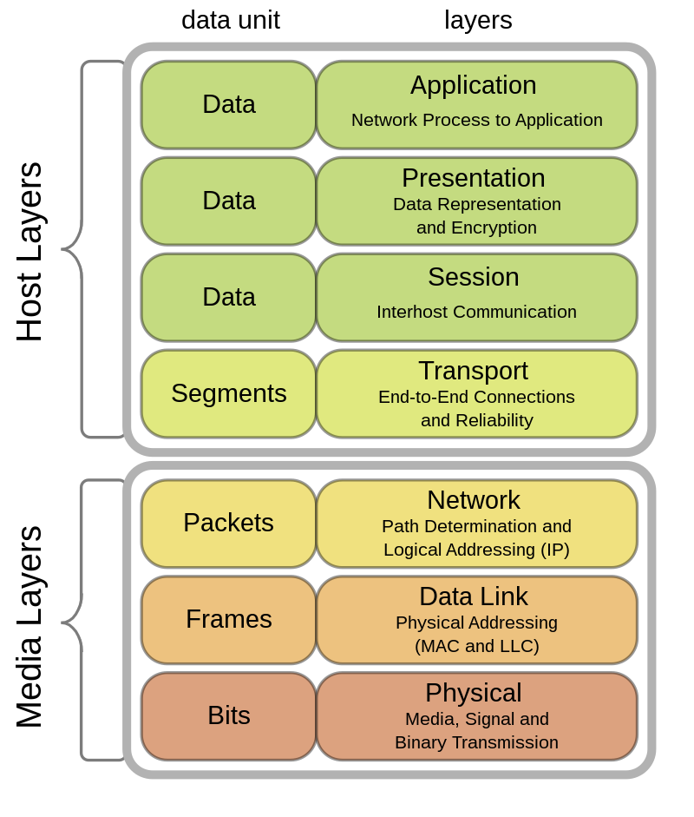
OSI Model

Slide 57
OSI Model
Application
Protocols specific to applications
Presentation
Translates between networking services
and applications (e.g., encoding, encryption)
Session
Manages communication sessions
Transport
Directs data to an application
through a computer port
Network
Routes data from a computer to another
in a different network using an address
Data Link
Transmits data frames between
two physically connected nodes
Physical
Translates between binary data
and network signals

Slide 58
Application Protocols
HTTP (Hypertext Transfer Protocol)
HTTPS (Hypertext Transfer Protocol Secure)
SMTP
FTP
Telnet

Slide 59
Application Protocols
HTTP (Hypertext Transfer Protocol)
HTTPS (Hypertext Transfer Protocol Secure)
SMTP
FTP
Telnet
Encryption

Slide 60
Application Protocols
HTTP (Hypertext Transfer Protocol)
HTTPS (Hypertext Transfer Protocol Secure)
SMTP
FTP
Telnet
Encryption
Subdomains
URL parameters
Cookies
Requests
Page content

Slide 61






Websites
Text files
Media files

Slide 62


Websites
Text files
Media files
Cookies

Slide 63
Websites
Text files
Media files
Web Servers serve them
Browsers receive and interpret them

Slide 64

Servers ↔ Browsers

Slide 65
Servers ↔ Browsers
Requests
&
Responses

Slide 66
Servers ↔ Browsers
Requests
&
Responses
For World Wide Web (WWW)
HTTP & HTTPS

Slide 67
Servers ↔ Browsers
Requests
&
Responses
Here’s 156.33.241.5 google.com Please!

Slide 68






Servers ↔ Browsers
Requests
&
Responses
Google’s server (Not really……
it’s complicated)
Here’s 156.33.241.5 google.com Please!
Here you go!

Slide 69
Servers ↔ Browsers
Requests
&
Responses
Google’s server (Not really……
it’s complicated)
But where are those?
Here’s 156.33.241.5 google.com Please!
Here you go!

Slide 70
Domain Names (Hostnames)
Readable unique addresses
harvard.edu
google.com
ycc.vision
They cost a small amount of annual fee
Translated to IP address by Domain Name System (DNS) servers
Your ISP configured your modem already to closer DNS servers
You can pick your own still (Security warning)

Slide 71
Domain Names (Hostnames)
Readable unique addresses
harvard.edu
google.com
ycc.vision
They cost a small amount of annual fee
Translated to IP address by Domain Name System (DNS) servers
Your ISP configured your modem already to closer DNS servers
You can pick your own still (Security warning)

Slide 72
Servers ↔ Browsers
How does server respond? (Who’s reading the request?)
Here’s 156.33.241.5 google.com Please!
Here you go!

Slide 73

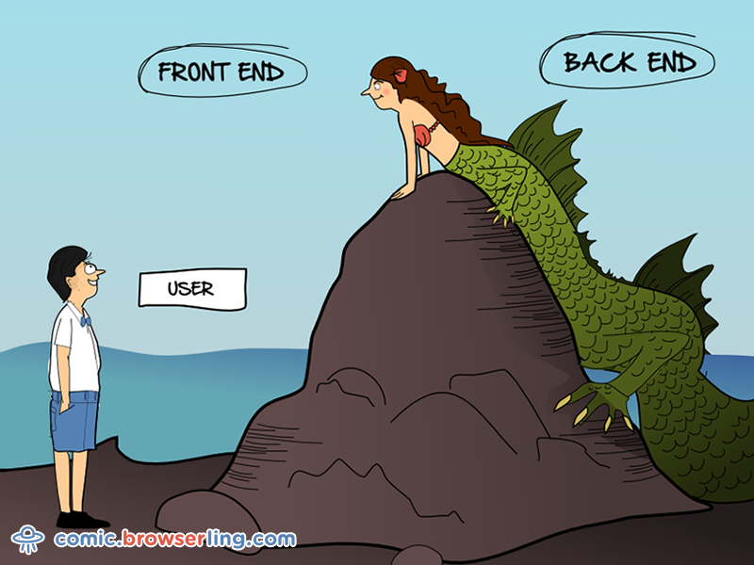
The Backend

Slide 74

Client (User)
Frontend

Slide 75



Server
Client (User)
Backend
Frontend

Slide 76
Server
Server-Side Languages
Manage requests
Produce Responses
PHP, NodeJS
Python, MySQL
Etc.
Backend

Slide 77
Server
Server-Side Languages
Manage requests
Produce Responses
PHP, NodeJS
Python, MySQL
Etc.
Do I always need these?
Backend

Slide 78
Static vs. Dynamic Websites
Two ways of updating websites
Modify the code directly
Posting using forms (e.g., comments and blogs)

Slide 79
Static vs. Dynamic Websites
Two ways of updating websites
Modify the code directly
Posting using forms (e.g., comments and blogs)
Fundamentally different structures
Static: Display the same content (e.g., personal website)
Dynamic: Requests change the website permanently by triggering server-side scripts (e.g., saving data from experiments)

Slide 80
Static vs. Dynamic Websites
Two ways of updating websites
Modify the code directly
Posting using forms (e.g., comments and blogs)
Fundamentally different structures
Static: Display the same content (e.g., personal website)
Dynamic: Requests change the website permanently by triggering server-side scripts (e.g., saving data from experiments)
Many free services available to host static sites!
(e.g., Github)

Slide 81
Outline
How the modern internet works
How online experiment works
Basic concepts and structures of websites
HTML, CSS, JavaScript, JQuery, PHP, ……
Common problems and solutions
How to stay current?
Example code
Extra bit on personal website
Return to Outline link page

Slide 82
Components
Building experiments
Hosting websites
Rendering experiments
Receiving and storing data
Recruiting subjects
Sauter, M., Draschkow, D., Mack, W. (2020). Building, hosting and recruiting: A brief introduction to running behavioral experiments online. Brain Sciences, 10:251, 1-11.
Table 1 (p. 3)

Slide 83
Building experiments
Backend
Frontend

Slide 84







Building experiments
Wrapper: Extra code
Backend
Frontend

Slide 85
Building experiments
Wrapper: Extra code
Backend
Frontend

Slide 86
Building experiments
Wrapper: Extra code
Backend
Frontend

Slide 87

Hosting websites
You (Experimenter)
Frontend
Backend
Frontend
Backend

Slide 88
Hosting websites
Server
You (Experimenter)
Frontend
Backend
Frontend
Backend

Slide 89
Hosting websites
Server
Upload
FTP software (FileZilla, WinSCP, Cyberduck)
You (Experimenter)
Frontend
Backend
Frontend
Backend
Frontend

Slide 90
Hosting websites
Server
Client (User)
Frontend
Backend
Frontend

Slide 91
Hosting websites
Requests
I am here to see https://example.com
Server
Client (User)
Frontend
Backend
Frontend

Slide 92
Hosting websites
Requests
I am here to see https://example.com
Server
Client (User)
Response
Here are the files
Backend
Frontend
Frontend

Slide 93
Hosting websites
Server
Response
Here are the files
Backend

Slide 94
Hosting websites
Server
Response
Here are the files
Backend
Not all hosting services allowed executing your own code on servers
Github
Services for researcher (e.g., JATOS, Pavlovia)
Shared web hosting service (e.g., Dreamhost, Herokuapp)
Self-managed lab servers

Slide 95
Rendering experiments
Client (User)
Frontend

Slide 96
Rendering experiments
Client (User)
Frontend

Slide 97
Receiving and storing
Requests
Hey, I am done! Here are the data…
Server
Client (User)
Backend
Frontend
Frontend

Slide 98
Receiving and storing
Requests
Hey, I am done! Here are the data…
Server
Client (User)
Response
(save data) “ok bye”
Backend
Frontend
Frontend

Slide 99
Receiving and storing
Server
Response
(save data) “ok bye”
Backend

Slide 100
Receiving and storing
Server
Response
(save data) “ok bye”
Backend
Database (e.g., MySQL)
Csv or txt files

Slide 101
Receiving and storing
Server
Response
(save data) “ok bye”
Backend
Database (e.g., MySQL)
Csv or txt files
How to keep them safe?

Slide 102
Receiving and storing
Server
Response
(save data) “ok bye”
Backend
Database (e.g., MySQL)
Csv or txt files
How to keep them safe?
It’s complicated……
(Server configurations, password for database, etc.)

Slide 103
Recruiting subjects
Client (User)
Amazon Mturk: https://www.mturk.com/
TurkPrime Panel: https://www.cloudresearch.com/
Prolific: https://www.prolific.co/
Qualtrics Panel: https://www.qualtrics.com/research-services/online-sample/
LabintheWild (free): https://www.labinthewild.org/

Slide 104
No permission for server-side scripting?
Email.js sends data to your email directly from the client-side script https://www.emailjs.com/

Slide 105
Outline
How the modern internet works
How online experiment works
Basic concepts and structures of websites
HTML, CSS, JavaScript, JQuery, PHP, ……
Common problems and solutions
How to stay current?
Example code
Extra bit on personal website
Return to Outline link page

Slide 106
Building experiments
Backend
Frontend

Slide 107
Necessary part of a website
Everything you see are HTML elements
Hidden things can be HTML elements as well
Can be created by JavaScript
Slow
Hard to read
Hard to debug
Hard to update
Can hurt ranking in search results

Slide 108
Specify the appearance (style) of each elements
Can be done in HTML element “style” attribute directly
While this is convenient at times, it is again hard to read, debug, and update

Slide 109
This is the only one that is actually a programming language
CSS could act like a programming language, but you should just pretend you’ve never heard that
It manipulate things
HTML + CSS are the bones and skins of the things themselves
Any interactive functions
Not related to Java (annoying!)

Slide 110

A must-use JS library/framework
Simplify code
Easier to learn
Better compatibility across browsers
Useful new functions
Amazing AJAX functions

Slide 111
The older commonly used server-side language
I have been using PHP to save data (hiding behind JQuery AJAX)
NodeJS and python are modern alternatives

Slide 112
Resources & Tools
W3School tutorials https://www.w3schools.com/
MDN tutorials (the Mozilla Developer Network) https://developer.mozilla.org/en-US/docs/Learn
CSS-Tricks (More good tutorials for front-end programming) https://css-tricks.com/
Visual Studio Code text editor (programming) https://code.visualstudio.com/
JSFiddle (debugging/code sharing) https://jsfiddle.net/
CodePen (debugging/code sharing) https://codepen.io/
PHP Sandbox (debugging) http://sandbox.onlinephpfunctions.com/
Browsersync (slightly more advanced tool for debugging) https://www.browsersync.io/
W3C Markup Validation Service (checking your code against HTML5 standard) https://validator.w3.org/
Google Fonts (fonts) https://fonts.google.com/
Noun Project (icons) https://thenounproject.com/
Font Awesome (icons) https://fontawesome.com/
Academicons (Icons) https://jpswalsh.github.io/academicons/

Slide 113
JavaScript (JS) quirks
Asynchrony but single-threaded

Slide 114
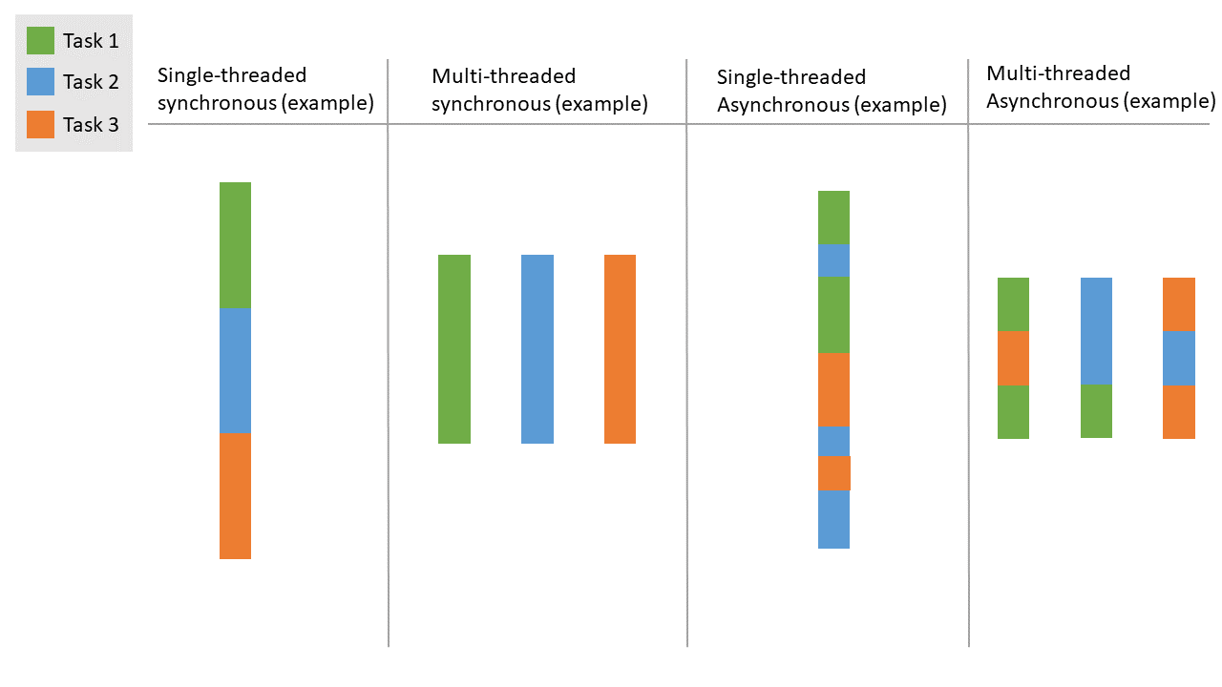

Slide 117
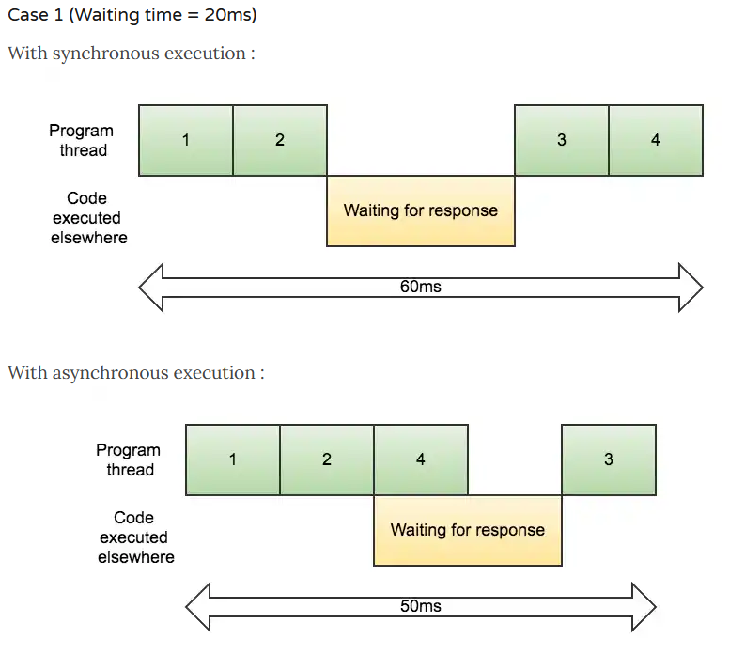
https://www.sohamkamani.com/blog/2016/03/14/wrapping-your-head-around-async-programming/

Slide 118
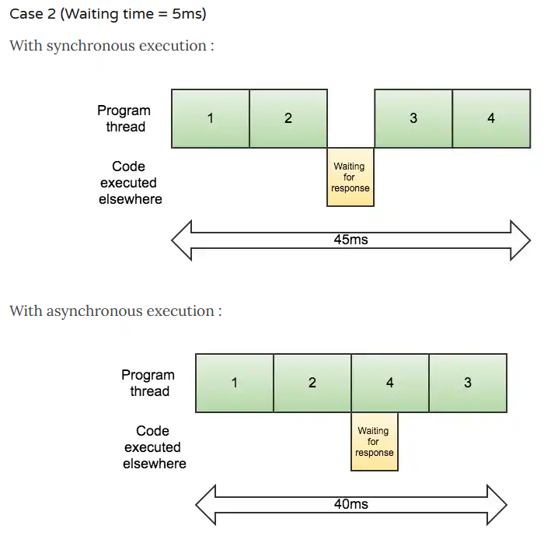
https://www.sohamkamani.com/blog/2016/03/14/wrapping-your-head-around-async-programming/

Slide 119
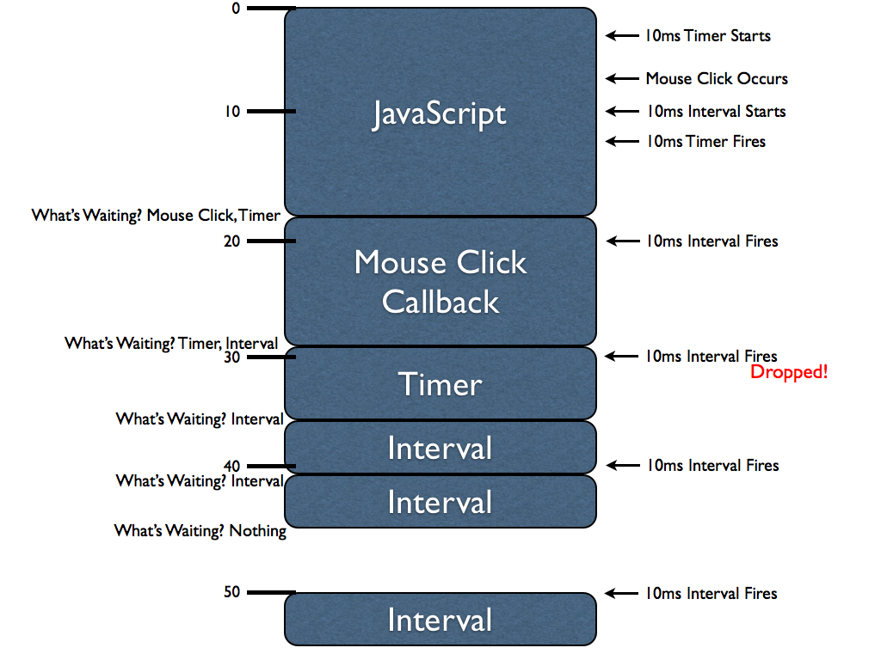
https://johnresig.com/blog/how-javascript-timers-work/

Slide 120
JavaScript (JS) quirks
Loosely typed
Equality (“==“ vs. “===“) https://codeburst.io/javascript-double-equals-vs-triple-equals-61d4ce5a121a
Surprising conversion https://www.w3schools.com/js/js_type_conversion.asp (See JavaScript Type Conversion Table)
Funny default scope and hoisting https://www.w3schools.com/js/js_scope.asp https://www.w3schools.com/js/js_hoisting.asp
Everchanging this https://www.w3schools.com/js/js_this.asp
undefined & null https://codeburst.io/javascript-null-vs-undefined-20f955215a2
More on WTFJS https://github.com/denysdovhan/wtfjs

Slide 121
Outline
How the modern internet works
How online experiment works
Basic concepts and structures of websites
HTML, CSS, JavaScript, JQuery, PHP, ……
Common problems and solutions
How to stay current?
Example code
Extra bit on personal website
Return to Outline link page

Slide 122
Common practices to be
Debugging in style
Browser compatibility
Avoiding touch devices
Quality auditory stimuli
Things should be in view
The problem of size
The problem of color
Slow or interrupted internet
Interruption from tab-switching
Smooth videos
Timing precision
Eye-tracking? Yes!
Subjects’ language fluency
Subjects’ sensory impairments
Repeated participation
Robot screening
Length of experiments
Watching data quality
Integration with SONA credit granting

Slide 123
Debugging in style
Firebug in Firefox
Chrome DevTools
You can host your website locally (temporally) to test server-side scripts
Static server one liner (command line) https://gist.github.com/willurd/5720255
Alternatively: Use Node.js + Browsersync https://nodejs.org/en/ https://www.browsersync.io/

Slide 124
Browser compatibility
Browser sniffing
Use UserAgent to detect what browser is used
Can I use… Browser war status https://caniuse.com/
Not a good idea anymore!
Feature detection
Directly detect if the relevant features you are hoping to use are provided
Library like Modernizr
Or just vanilla JavaScript (examples follow…)
Can I use… Feature support

Slide 125
Browser compatibility
Browser sniffing
Use UserAgent to detect what browser is used
Can I use… Browser war status https://caniuse.com/
Not a good idea anymore!
Feature detection
Directly detect if the relevant features you are hoping to use are provided
Library like Modernizr
Or just vanilla JavaScript (examples follow…)
Can I use… Feature support

Slide 126
Browser compatibility
Browser sniffing
Use UserAgent to detect what browser is used
Can I use… Browser war status https://caniuse.com/
Not a good idea anymore!
Feature detection
Directly detect if the relevant features you are hoping to use are provided
Library like Modernizr
Or just vanilla JavaScript (examples follow…)
Can I use… Feature support

Slide 127
Browser compatibility
Instead of adjusting experiments for older browsers, you may also ask subjects to update browsers before participating by visiting this website: https://browser-update.org/update.html
For delicate experiments that heavily depends on compatibility, here's a paid service to test cross-platform/browser compatibility comprehensively: https://www.browserstack.com/

Slide 128
Avoiding touch devices
Device sniffing
Detection from userAgent
Feature detection
Display size detection, e.g., JQuery $(window).width() JavaScript element.getBoundingClientRect()
Keyboard access (“press space to continue”)

Slide 129
Quality auditory stimuli
Headphone detection Woods, K. J., Siegel, M. H., Traer, J., & McDermott, J. H. (2017). Headphone screening to facilitate web-based auditory experiments. Attention, Perception, & Psychophysics, 79, 2064-2072.

Slide 130


Headphones test
speaker
speaker
(Woods, Siegel, Traer, & McDermott, 2017, AP&P)

Slide 131
Headphones test
Anti-phase
speaker
speaker
(Woods, Siegel, Traer, & McDermott, 2017, AP&P)

Slide 132

Headphones test
Anti-phase
Headphones
(Woods, Siegel, Traer, & McDermott, 2017, AP&P)

Slide 133
General lesson
Test whatever you need with clever design!

Slide 134
Things should be in view!
Measure if stimuli is in full view in each trial
JavaScript element.getBoundingClientRect()
I’ll share a link to my example code using this (look for CHECK_FULLY_IN_VIEW)

Slide 135
The problem of size
Any size that works (visible in full)
Measure if stimuli is fully in view with JavaScript
Normal size (just not crazy)
Ask the subject to adjust
Arm length distance and thumb nail size
As big as possible
As small as still discernible
Accurate size
Li, Q., Joo, S. J., Yeatman, J. D., Reinecke, K. (2020). Controlling for participants’ viewing distance in large-scale, psychophysical online experiments using a virtual chinrest. Scientific Report,10:904.
Credit card standard size & blind spot detection
https://github.com/QishengLi/virtual_chinrest/

Slide 136
The problem of color
Color perception
Color blind test
Color sensitivity test
Monitor calibration
Psychophysics methods (e.g., color-mixing matching, apparent motion forced choice) To, L., Woods, R. L., Goldstein, R. B., & Peli, E. (2013). Psychophysical contrast calibration. Vision research, 90, 15-24.
Time-consuming and complicated for subjects

Slide 137
Slow or interrupted internet
Preload images, videos, and sounds before presentation
Images
Preloading works reliably across platforms only if the elements are set to be displayed
Workaround: invisible buffer div (see example code)
Audios & Videos
Preloading too tricky to deal with
Workaround: canplaythrough event https://www.w3schools.com/tags/av_event_canplaythrough.asp (More details on caveats: http://dinbror.dk/blog/how-to-preload-entire-html5-video-before-play-solved/)
You may test the effect of internet speed on your experiment by throttling the network https://css-tricks.com/throttling-the-network/

Slide 138
Interruption from tab-switching
There are no perfect way so far to detect window- or tab-switching
Onfocus & onblur have poor cross-platform compatibility and they are fading out and not recommended
Page visibility API detect minimization or tab-switching, but not window-switching without minimization
Use page visibility API is still better nothing
See my example code (linked at the end)

Slide 139
Smooth videos
requestAnimationFrame() for smooth (equivalent to frame counting for Psychtoolbox and PsychoPy)
https://developer.mozilla.org/en-US/docs/Web/API/window/requestAnimationFrame
https://stackoverflow.com/questions/38709923/why-is-requestanimationframe-better-than-setinterval-or-settimeout
https://hacks.mozilla.org/2011/08/animating-with-javascript-from-setinterval-to-requestanimationframe/
NOTE
Tradeoff between smooth animation and accurate timing
Combined with duration recording to fix the inaccuracy (case-by-case considerations)

Slide 140
Timing precision
RT recording & Display timing
Bridges, Pitiot, MacAskill, Peirce (2020).The timing mega-study: Comparing a range of experiment generators, both lab-based and online. PsyArXiv.
Anwyl-Irvine, Dalmaijer, Hodges, Evershed (2020). Online Timing Accuracy and Precision: A comparison of platforms, browsers, and participant‘s devices. PsyArXiv.
Anwyl-Irvine, A. L., Massonnié, J., Flitton, A., Kirkham, N., & Evershed, J. K. (2020). Gorilla in our midst: An online behavioral experiment builder. Behavior research methods, 52, 388-407.

Slide 141
RT recording
Through event handlers
Mouse clicks
Keystrokes

Slide 142
https://johnresig.com/blog/how-javascript-timers-work/

Slide 143
RT recording
Through event handlers
Mouse clicks
Keystrokes
~80 ms delay (SD=~20ms)
~10-40 ms from software (JavaScript & Browsers)

Slide 144
Display timing
About -10~60ms
less than 10 ms from software when optimally programmed with up-to-date packages
More research is needed on this with various functions
BTW if you use PsychoPy, update to 3.2!
Controlling
requestAnimationFrame()
setInterval()
setTimeout()
Recording
Date.now()

Slide 145
Eye-tracking? Yes!
Conservative estimate of accuracy (2018)
~4º in visual angle
17% screen size
200 px
Gorilla has integrated WebGazer.js toolbox
Caveat
30-min calibration (can be shorten though)
Reference
Semmelmann, K., & Weigelt, S. (2018). Online webcam-based eye tracking in cognitive science: A first look. Behavior Research Methods, 50, 451-465.
Another option: GazeCouldAPI.js https://gazerecorder.com/gazecloudapi/

Slide 146
Subjects’ language fluency
Location limited to US
English test
At least one open-ended questions
Pre-registered exclusion for non-sense (e.g., the weirdly common “GOOD”)
Instruction forced-choice quizzes
Pre-registered exclusions for many attempts
Terminate the experiment if failed many times

Slide 147
Subjects’ sensory impairments
Color blindness as mentioned before
Acuity (normal or corrected-to-normal vision)
Achievable with viewing distance measure
Can be done just for your own experiment (e.g., ensure they can see your stimuli clearly)

Slide 148
Repeated participation
Most subject recruiting platforms take care of this
Mturk
Batch assign qualification to participated workers
Set criteria to qualification not assigned
Ask directly in debriefing: “Have you participated in this study before?”
“You will be paid regardless your answer. Please be honest. Thanks!”
Maintain your own list of worker IDs
You need to know about security

Slide 149
Robot screening
Captcha = Completely automated public Turing test to tell computers and humans apart
Also used to annotate images
Free labor for Google!
hCaptcha allowed the site owner to earn rewards: https://www.hcaptcha.com/
Implementation involved server-side scripting

Slide 150
Length of experiments
People said < 15 mins
30 mins are fine in my experience
Design with your subjects’ comfort in mind
You could play a fun game for hours
Give breaks
Show progress
Make it meaningful
Give interesting feedback at the end http://tutorial.labinthewild.org/
Mturkers (and maybe most online subjects) are mostly highly educated

Slide 151
Watching data quality
Not different if not better than in-lab expts
If a design decision
Add noises: Run bigger sample
Add biases: Fix it
Write instructions for people who has never heard of any studies
Design it as neat and short as possible (visually as well!)
https://cantunsee.space/
https://www.nngroup.com/articles/characteristics-minimalism/
Flat, simplistic, spacious, Sans Serif
When there’s opportunity to interaction, show a signal (e.g., hovering pointer and link style)
Interactions should lead to responses (e.g., active links)

Slide 152
Watching data quality
Make the task meaningful
Chandler, D.; Kapelner, A. Breaking monotony with meaning: Motivation in crowdsourcing markets Journal of Economic Behavior & Organization 2013, 90, 123–133, doi:10.1016/j.jebo.2013.03.003.
Impose sufficient time-limit
“You will be given 30 minutes for this experiment, which is going to be much shorter than that if you pay full attention.”
“If you don’t focus on it though, the experiment might terminate before you are able to complete it.”
“There will be opportunity for you to rest and these are excluded from the time limit.”
Rodd, J. (2019). How to Maintain Data Quality When You Can't See Your Participants. APS Observer, 32(3). https://www.psychologicalscience.org/observer/how-to-maintain-data-quality-when-you-cant-see-your-participants

Slide 153
Screening and exclusions
Instruction quizzes as screening or exclusions
Opportunity for feedback with open-ended question
Fixing potential problems
Excluding non-sensical responses
Farmers or bots responded identically
Captcha (e.g., hCaptcha)
Measuring reading time for instructions
Tab defocusing detection
https://developer.mozilla.org/en-US/docs/Web/API/Page_Visibility_API
This is the best exist: No perfect method to detect all defocusing events so far

Slide 154
Data quality references
Armitage, J., Eerola, T. (2020). Reaction time data in music cognition: comparison of pilot data from lab, crowdsourced, and convenience web samples.
Bartneck, C., Duenser, A., Moltchanova, E., Zawieska, K. (2015). Comparing the Similarity of Responses Received from Studies in Amazon’s Mechanical Turk to Studies Conducted Online and with Direct Recruitment.
Gould, S.J.J., Cox, A.L., Brumby, D.P., Wiseman, S. (2015). Home is where the lab is: A comparison of online and lab data from a time-sensitive study of interruption.
Hauser, D.J., Schwarz, N. (2015). Attentive Turkers: MTurk participants perform better on online attention checks than do subject pool participants.
Hilbig, B.E. (2015). Reaction time effects in lab- versus Web-based research: Experimental evidence.
Leeuw, J.R.d., Motz, B.A. (2015). Psychophysics in a Web browser? Comparing response times collected with JavaScript and Psychophysics Toolbox in a visual search task.
Clifford, S., Jerit, J. (2014). Is there a cost to convenience? An experimental comparison of data quality in laboratory and online studies.
Casler, K., Bickel, L., Hackett, E. (2013). Separate but equal? A comparison of participants and data gathered via Amazon’s MTurk, social media, and face-to-face behavioral testing.
Dandurand, F., Shultz, T.R., Onishi, K.H. (2008). Comparing online and lab methods in a problem-solving experiment.

Slide 155
Integration with SONA credit granting
Automatic sona credit granting http://www.sona-systems.com/help/
This can be done with most survey tools and customized websites

Slide 156
Outline
How the modern internet works
How online experiment works
Basic concepts and structures of websites
HTML, CSS, JavaScript, JQuery, PHP, ……
Common problems and solutions
How to stay current?
Example code
Extra bit on personal website
Return to Outline link page

Slide 157
Staying current
Start current
Read official documentations
Pick your source of information
On Stack Overflow, answers to Python-related questions can be useful for many years
You should assume within a year or two the answers are outdated for web programming
Most of the tutorials are not up-to-date
No copy-pasting mindlessly
https://caniuse.com/

Slide 158
Staying current
Start current
Read official documentations
Pick your source of information
On Stack Overflow, answers to Python-related questions can be useful for many years
You should assume within a year or two the answers are outdated for web programming
Most of the tutorials are not up-to-date
No copy-pasting mindlessly
https://caniuse.com/

Slide 159
Staying current
Start current
Read official documentations
Pick your source of information
On Stack Overflow, answers to Python-related questions can be useful for many years
You should assume within a year or two the answers are outdated for web programming
Most of the tutorials are not up-to-date
No copy-pasting mindlessly
Can I use… https://caniuse.com/

Slide 160
Staying current
Maintenance
You need to read tech news!
Keep up with online testing related publications

Slide 161
Staying current
For personal website
Google analytics and StatCounter records
Google analytics diagnosis
Test speed
Loading order
Media size
Media format
Server configuration (where the server is, code to execute on the server)
Regularly visit to check for broken functions

Slide 162
Outline
How the modern internet works
How online experiment works
Basic concepts and structures of websites
HTML, CSS, JavaScript, JQuery, PHP, ……
Common problems and solutions
How to stay current?
Example code
Extra bit on personal website
Return to Outline link page

Slide 163
Example rating experiment
Here is an example rating experiment: https://ycc.cvls.online/tools/example/?PROLIFIC_PID=1234
The code used can be found in the latest release: https://github.com/Yi-Chia-Chen/js-expt-toolbox/releases

Slide 164
Outline
How the modern internet works
How online experiment works
Basic concepts and structures of websites
HTML, CSS, JavaScript, JQuery, PHP, ……
Common problems and solutions
How to stay current?
Example code
Extra bit on personal website
Return to Outline link page

Slide 165
Personal Website
Personal Website building & design
HTTPS
your-domain.com
Common design
Sitemap for bots

Slide 166
Main website building methods
Content Management System (CMS)
Wordpress
Wix
Static Site Generator (SSG)
HUGO
Gatsby
Nuxt.js
Next.js
HARDCORE HAND-CODED WEBSITES!

Slide 167
Main website building methods
Content Management System (CMS)
Wordpress
Wix
Static Site Generator (SSG)
HUGO
Gatsby
Nuxt.js
Next.js
HARDCORE HAND-CODED WEBSITES!
Hosted by free service or your own servers

Slide 168
Main website building methods
Content Management System (CMS)
Wordpress
Wix
Static Site Generator (SSG)
HUGO
Gatsby
Nuxt.js
Next.js
HARDCORE HAND-CODED WEBSITES!
Hosted by free service or your own servers

Slide 169
Main website building methods
Content Management System (CMS)
Wordpress
Wix
Static Site Generator (SSG)
HUGO
Gatsby
Nuxt.js
Next.js
HARDCORE HAND-CODED WEBSITES!
Hosted by free service or your own servers

Slide 170
Code your website
Step 1: Plan your layout on phone screen
Step 2: Plan your layout on tablet
Step 3: Plan your layout on larger screen
Step 4: HTML with placeholder content
Step 5: CSS
Step 6: Complete the content
Step 7: Refine CSS
Step 8: Add your JavaScript magics

Slide 171
Code your website
Step 1: Plan your layout on phone screen
Step 2: Plan your layout on tablet
Step 3: Plan your layout on larger screen
Step 4: HTML with placeholder content
Step 5: CSS
Step 6: Complete the content
Step 7: Refine CSS
Step 8: Add your JavaScript magics

Slide 172
Use a JS framework
Pure JavaScript (so-called vanilla JavaScript) is too primitive for modern sophisticated websites
JS frameworks
Simplified syntax and coding process
Make code more readable and shorter
Popular client-side examples
JQuery (typically referred to as a library)
Angular
ReactJS
Vue.js

Slide 173
Publish your website
Step 1: Upload your code
Your own servers
Github, Herokuapp, etc.
Step 2: Configure the server side
Step 3: Bind a domain name
You can buy them online many ways
Google domain is easy with lots of options
How to:
https://help.github.com/en/github/working-with-github-pages/managing-a-custom-domain-for-your-github-pages-site
https://dev.to/trentyang/how-to-setup-google-domain-for-github-pages-1p58

Slide 174
Basic example
https://yi-chia-chen.github.io/swtsui/
https://github.com/Yi-Chia-Chen/swtsui

Slide 175
SEO
Search engine optimization
Site loading speed
Meaningful inbound links
Link it everywhere you have a profile
Sitemap
Register with Google Search Console
No single-page “scrolling” website
Google analytics and Statcounter
Phone visitors are the majority (responsive website design)
Secure static website

Slide 176
Design tips
Style
Flat, simplistic, spacious, Sans Serif
Follow current trend to appear safe and relevant
Little things
When there’s opportunity to interaction, show a signal (e.g., hovering pointer and link style)
Interactions should lead to responses (e.g., active links)
Keep visitor on your site (e.g., open new window)
Keep in mind your future needs

